Slide 1


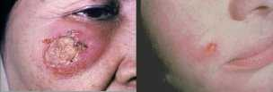
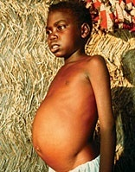
Development of a controlled human challenge model for leishmaniasis
Paul Kaye and Vivak Parkash on behalf of the LEISH Challenge team
York Biomedical Research Institute
Hull York Medical School, University of York

Slide 2

Contents of the talk
the need for a human challenge model
outline of MRC / DFiD funded DPFS project
progress towards a GMP line of L. major
patient and public involvement
FLYBITE study - preliminary data

Slide 3
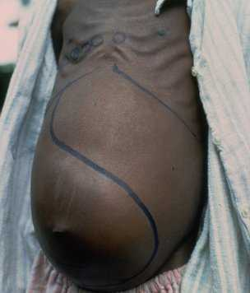
The major clinical presentations of leishmaniasis
Visceral leishmaniasis (VL; kala-azar)
fatal if left untreated
irregular fevers, weight loss, hepato-splenomegaly, anaemia.
Brazil, East Africa and in South-East Asia.
95% of reported new cases in 10 countries: Bangladesh, Brazil, China, Ethiopia, India, Kenya, Nepal, Somalia, South Sudan and Sudan.
50 000 to 90 000 reported new cases of VL occur worldwide p.a.
Approx. 20 000 deaths p.a.
Cutaneous leishmaniasis (CL)
skin lesions, mainly ulcers, on exposed parts of the body, leaving life-long scars and serious disability or stigma.
95% of CL cases in the Americas, the Mediterranean basin, the Middle East and Central Asia.
95% of reported CL cases in 6 countries: Afghanistan, Algeria, Brazil, Colombia, Iran (Islamic Republic of), Iraq and the Syrian Arab Republic.
600 000 to 1 million new cases occur worldwide p.a.

Slide 4
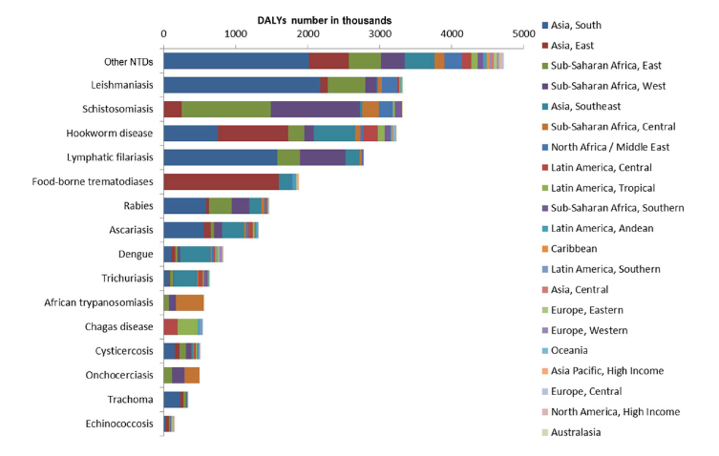
Leishmaniasis: ranked NTD morbidity

Slide 5
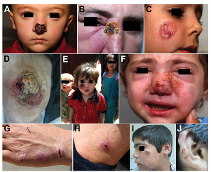
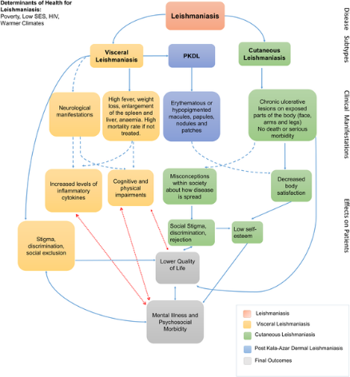



Leishmaniasis: consequences
Saroufim M, et al. Emerg Infect Dis.http://dx.doi.org/10.3201/eid2010.140288

Slide 6
Leishmaniasis: vaccine candidates in or near clinical trial

Slide 7
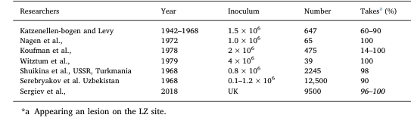
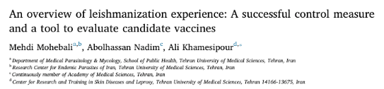
Leishmanization: “human challenge” to simulate natural protection
Berberian, D.A. Vaccination and immunity against Oriental Sore Trans. R. Soc. Trop. Med. Hyg., 33(1939), pp. 89-94 (34 volunteers; 80% take rate )
Leishmanization in the former USSR
Efficacy of leishmanization in Isfahan province, Iran.
scar + | No LZ | No new cases | Incidence/1000 | 95% CI | RR | p value
Pos | 8501 | 212 | 24.94 | 21.8 | 28.53
 |  |  |  |  | 31%
 |  |  |  |  | (24-39) | 0.001
Neg | 1011 | 97 | 95.95 | 78.63-117.07

Slide 8
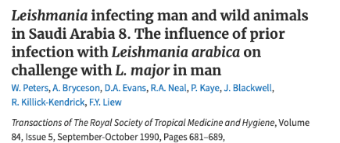
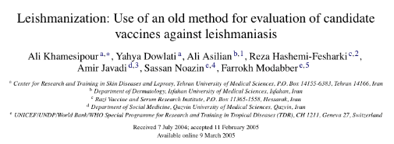
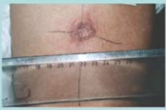
Early human “CHIM” studies
based on cross protection studies in mice
sand fly transmission; n=1
needle transmission; n=3
unvaccinated; n=1
Challenge 2x10⁶ L. major
Lesions in all volunteers, healing over 120 – 250 days
no evidence of protection
L. major stabilate made under GMP
19/23 (865) take rate in healthy previously non-exposed volunteers
74% ulcerated by d60; all lesions <3cm Ø
all healed between 75 and 285 days post onset w/o treatment
11 volunteers re-challenged; take rate 0% (0/11) vs 100% (5/5) in healthy controls
inoculum only 6% viable; poor take rates in mice

Slide 9
A CHIM for leishmaniasis: the LEISH Challenge Project
Why L. major?
single lesion; mild self limiting disease; Rx available; no evidence of reactivation on immune suppression; heterologous protection against VL
Why GMP?
QC; gives option for needle challenge
Why sand flies?
natural route; vector manipulates immunity; needle vaccination not protective against natural challenge
Ethical approval

Slide 10
Patient and Public Involvement
INVOLVE guidelines
Patient and Public Involvement group conducted in February 2019
  10 individuals, conducted by Health psychologist
  Recruited locally and nationally
  Mix of lay and professional represented
  NHS patient research ambassador and previous Oxford CHIM participant
Study design
Ethical issues + Consent
Recruitment

Slide 11
FLYBITE: A clinical study to develop a sand fly biting protocol using pathogen-free blood-fed sand flies*
Primary Objective
The development of a sand fly biting protocol, using pathogen-free sand flies, which is effective and safe for volunteers
Secondary Objectives
A. To determine human response to sand fly bite by (i) macroscopic, (ii) dermoscopic, (iii) immunological, and (iv) haematological / biochemical outcomes.
B. Determine attitudes to sand fly bite by way of post-study focus group with study participants
* Clinicaltrials.gov: NCT03999970

Slide 12
FLYBITE: Inclusion & Exclusion summary
Healthy adults aged 18 to 65 years
Willing to refrain from travel to regions where Leishmania-transmitting sand flies are present
No Recent receipt of vaccination
No recent administration of immunoglobulins
No history of significant allergic disease/atopy or drug allergy
No significant chronic skin condition
No history of leishmaniasis (RDT)
No significant history of travel to regions where Leishmania major-transmitting sand flies are endemic
No history of severe reaction to insect bites
Significantly raised IgE

Slide 13
FLYBITE: study design and visits
Pre-screening
(-40 to -14)
Visit 1
(-30 to -7)
Visit 2
(0)
Visit 3
(3 ± 1)
Visit 4
(10 ± 3)
Visit 5
(21 ± 5)
Pre-screening questionnaire
Screening tests
History & examination
Consent
History & exam
Sand fly biting visit
Photography
Dermoscopy
Videography
Symptom VAS
History & exam
Blood tests
Photography
Dermoscopy
Symptom VAS
History & exam
Blood tests
Photography
Dermoscopy
Symptom VAS
History & exam
Blood tests
Photography
Dermoscopy
Symptom VAS

Slide 14
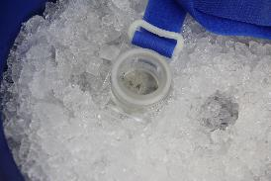
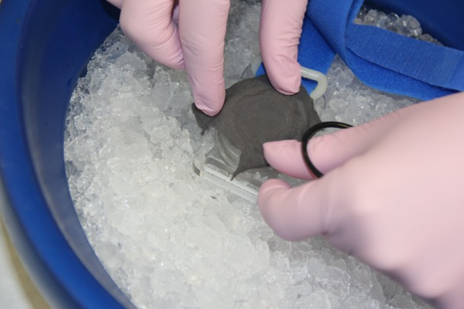
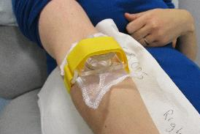
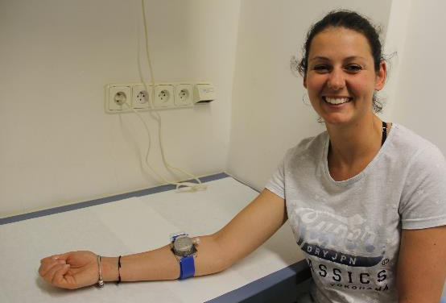
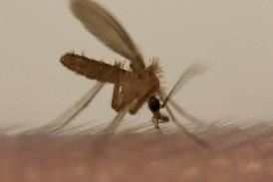
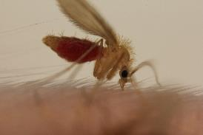
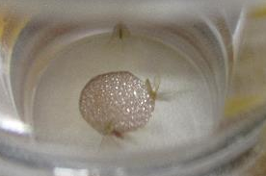
FLYBITE Biting chamber preparation

Slide 15
FLYBITE
Summary
✓
✓
✓
Remaining questions prior to human challenge
infectivity of GMP lot
treatment options / FU
ethical review
recruitment
lesion development
✓
✓
Ethical approval

Slide 16

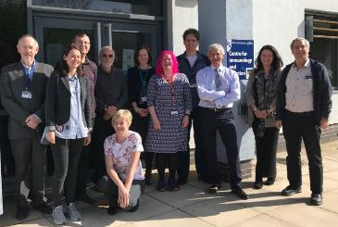







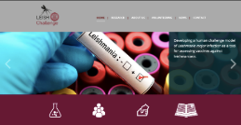


Acknowledgements
Stefano Malvolti
Melissa Malhame
Carsten Mantel
Alison Layton
NIH
Shaden Kamhawi
Jesus Valenzuela
Charle Jaffe
York
Paul Kaye
Charles Lacey
Liz Greensted
Alison Layton
Helen Ashwin
Vivak Parkash
Nicky Marshall
Jo Ingham
Jerusalem
Charle Jaffe
Eli Schwartz
Prague
Petr Volf
Barbara Vojtkova
Jovana Sadlova
McGill
Greg Matlashewski
Kai Lipinski
Marta Diaz-Guardamino
Leeds
Georgina Jones
https://leishchallenge.org
……..and our volunteers!

