Slide 1


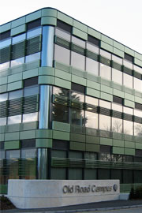
Controlled human mycobacterial infection models
Helen McShane
The Jenner Institute
University of Oxford

Slide 2
Why do we need a TB challenge model?
Uncertain predictive value of preclinical animal models
Lack of validated immune correlate of protection
Urgent need for an effective vaccine
  10m new cases and 1.5m deaths in 2018
We need tools for vaccine selection
BUT
TB Rx takes 6 months
Drugs can be toxic
5% chance of relapse
We can’t challenge with the virulent organism!

Slide 3
Some questions
How safe does a strain need to be?
How long does a strain have to live?
How sensitive does a reporter need to be?
What kind of vaccines would this work for?
Can we detect a vaccine effect?
Would this be acceptable to the regulators?

Slide 4
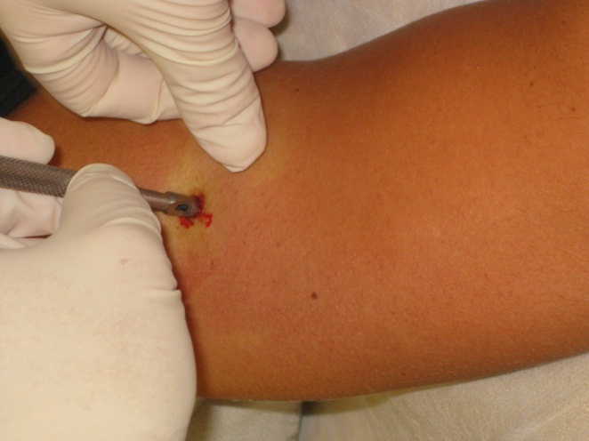
Human mycobacterial challenge models
An effective vaccine against BCG should also protect against M. tuberculosis
Does intradermal BCG ‘challenge’ provide a good model for aerosol M. tuberculosis challenge?
  Validation in preclinical animal models

Slide 5
BCG vaccination protects against intradermal and intranasal BCG challenge in mice
Minassian et al, PLoS One 2011

Slide 6

Validating intradermal BCG challenge in cattle
**
*
** p<0.01; *p<0.05
Villarreal-Ramos et al, Vaccine 2014

Slide 7
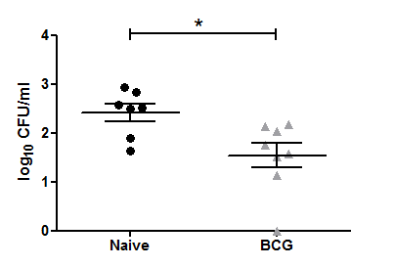
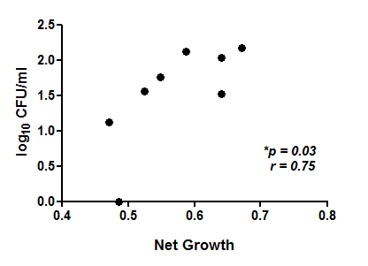
BCG vaccination protects against intradermal BCG challenge in NHPs
Harris et al, Tuberculosis 2018

Slide 8
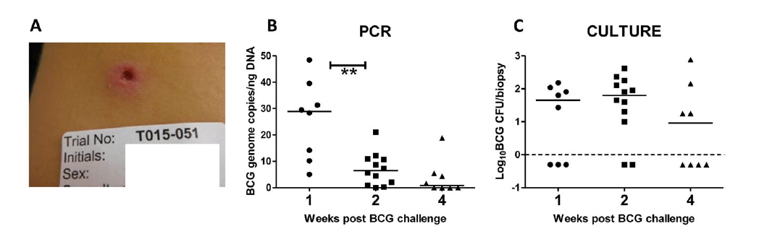
Pilot BCG challenge study
  BCG (SSI), 2-8 x 10⁵cfu/ 100ul
Route i.d
Sampling: 4mm punch biopsy
Biopsy at 1, 2, or 4 weeks post BCG
Minassian A et al, JID 2012

Slide 9
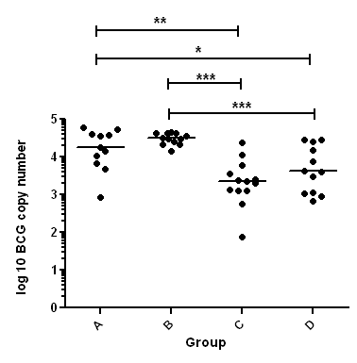
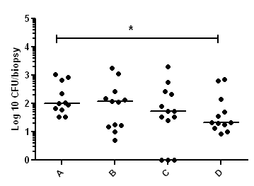
BCG challenge results for BCG and MVA85A vaccination
Culture
PCR
A = naïve
B = MVA85A
C = BCG
D = BCG-MVA85A
* p < 0.05
** p < 0.01
*** p < 0.001
Harris S et al, JID 2013

Slide 10
Comparing yield by strain and dose
Group A – low dose SSI
Group B – low dose TICE
Group C – high dose SSI
Group D – high dose TICE
Minhinnick A et al, JID 2015

Slide 11
Why give aerosol BCG?
As a controlled human challenge infection
As a more effective route of vaccination
As an approach to study the immunobiology of infection in humans

Slide 12
Outcomes in aerosol BCG study
Safety and tolerability
Can BCG be recoverable from BALF?
Th1 immunogenicity in the blood and BALF post aerosol v ID immunisation
Exploratory immunology
  MAITs
  B cells
  Antibodies

Slide 13
TB041
Aerosolised BCG in healthy, BCG-naïve, UK adults
BCG naïve, healthy UK adults
Original plan – BCG Danish (SSI)
  Group A – Aerosol BCG 1x10³ CFU (n=3)
  Group B – Aerosol BCG 1x10⁴ CFU (n=3)
  Group C – Aerosol BCG 1x10⁵ CFU (n=12)
  Group D – ID BCG 1x10⁵ CFU (n=12)
BCG Bulgaria (Intervax) – Arm 2
  Group 2A - Aerosol BCG 1x10⁴ CFU (n=3)
  Group 2B - Aerosol BCG 1x10⁵ CFU (n=3)
  Group 2C - Aerosol BCG 1x10⁶ CFU (n=3)
  Group 2D – Aerosol BCG 1x10⁷ CFU (n=3)
  Group 2E – Aerosol BCG 1x10⁷ CFU (n=9)
  Group 2F – ID BCG 1x10⁵ or 1x10⁶ CFU (n=12)

Slide 14

TB041: Delivering aerosol BCG to healthy BCG-naïve subjects
BCG (INH or ID)
Screen
D0
D2
D7
D14
D28
D84
D168
Bronchoscopy
PPD ELISpot @ D0, 7, 14, 28, 84, 168
WB ICS @ D0, 14 & 168
BAL ICS / detection of BCG by MGIT/PCR
Satti, Marshall et al, unpublished data

Slide 15
TB043:
Aerosol BCG to define immunobiology of disease
Aerosol BCG to 50 healthy subjects
15 controls
10 BCG and 3 controls receive bronchoscopy at one of the following time points:
  Days 2, 7, 14, 28, 56

Slide 16
TB043: Delivering aerosol BCG to healthy BCG-naïve subjects
BCG (INH or ID)
Screen
D0
D2
D7
D14
D28
D56
D84
D168
Bronchoscopy, BAL and endobronchial biopsies @ D2, D7, D14, D28 or D56
PPD ELISpot @ D0, 7, 14, 28, 84, 168
WB ICS @ D0, 14 & 168
BAL ICS / detection of BCG by MGIT/PCR
Single cell RNASeq on BAL cells
Satti, Marshall et al, unpublished data

Slide 17
Summary
Intradermal BCG challenge can detect a prior BCG vaccine effect in mice, cattle, NHPs and humans
Aerosol BCG is well tolerated
BCG is recoverable from the BAL fluid after aerosol BCG
Further studies needed to assess:
  if aerosol BCG is safe in historically BCG vaccinated individuals
  a BCG vaccine effect can be detected in historically BCG vaccinated individuals

Slide 18
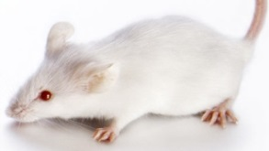
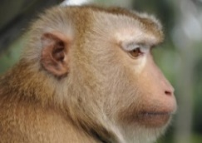
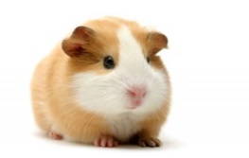
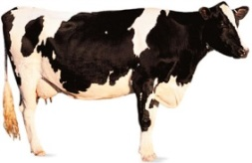
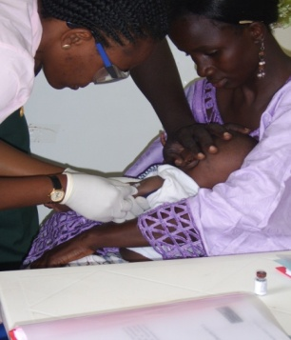
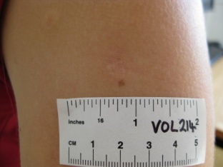
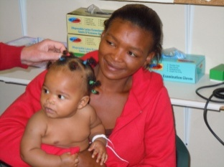
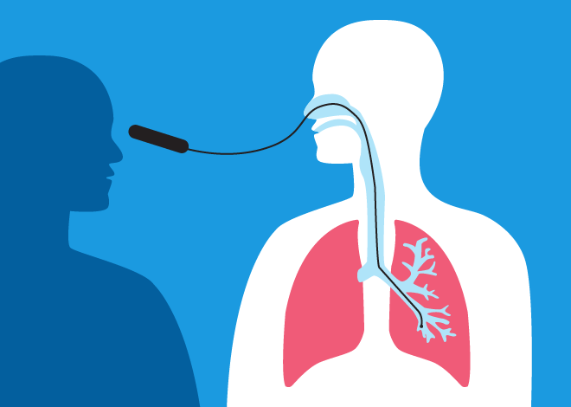
Animal models
Human safety & immunogenicity
Human field efficacy
Human challenge model
Toxicity
Mechanisms
Efficacy

Slide 19
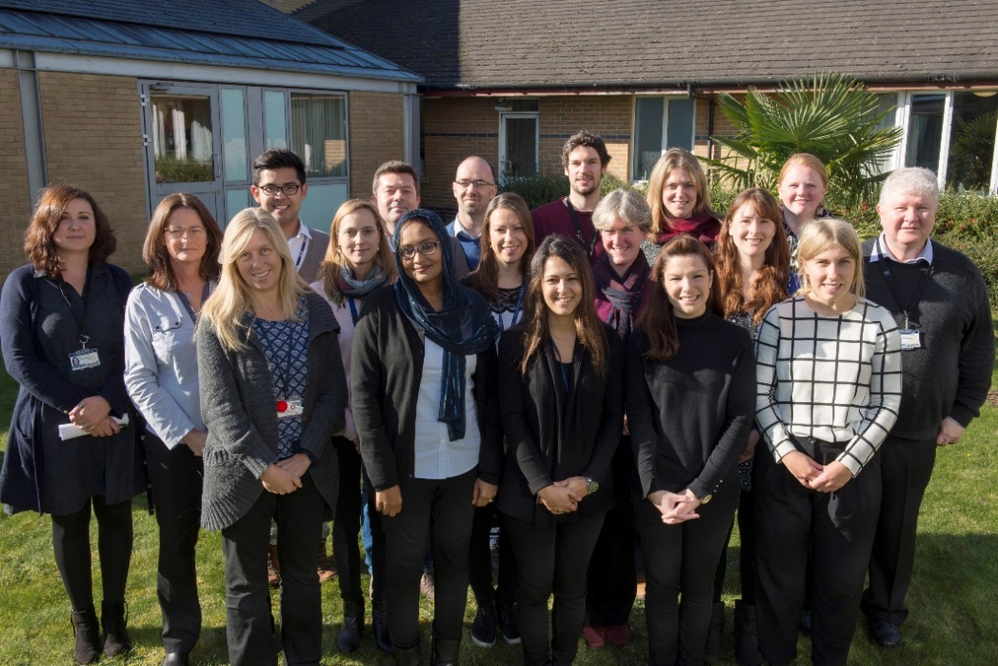




Acknowledgements
Iman Satti
Julia Marshall
Rachel Tanner
Stephanie Harris
Lisa Stockdale
Matt O’Shea
Magali Matsumiya
Zita Manjaly-Thomas
Sharon Sheehan
Ian Poulton
Raquel Ramon-Lopez
Alison Lawrie
Alice Minhinnick
Paulo Bettencourt
Morven Wilkie
Sam Vermaak
Elena Stylianou
Ilaria Pepponi
Lynda Stewart
Anne Kasmar
Willem Hanekom
Oxford Centre for Respiratory Medicine
  Henry Bettinson
Sally Sharpe
Andrew White
Ann Williams
Bernardo Villarreal Ramos
Martin Vordermeier
Glyn Hewinson
Study participants

