Slide 1
Developing Countries’ Vaccine Manufacturers’ Network International
Improving vaccination for all people

Slide 2
Mission: our purpose and mandate
To protect all people against known and emerging infectious diseases, by improving the availability of high-quality vaccines globally.

Slide 3
DCVMN International
It is a voluntary, non-governmental, non-partisan, not-for-profit, public health-driven alliance of vaccine manufacturers from developing countries, and research and policy organizations from all over the world.
Operates based on principles of access to international scientific, technical and economic cooperation.

Slide 4
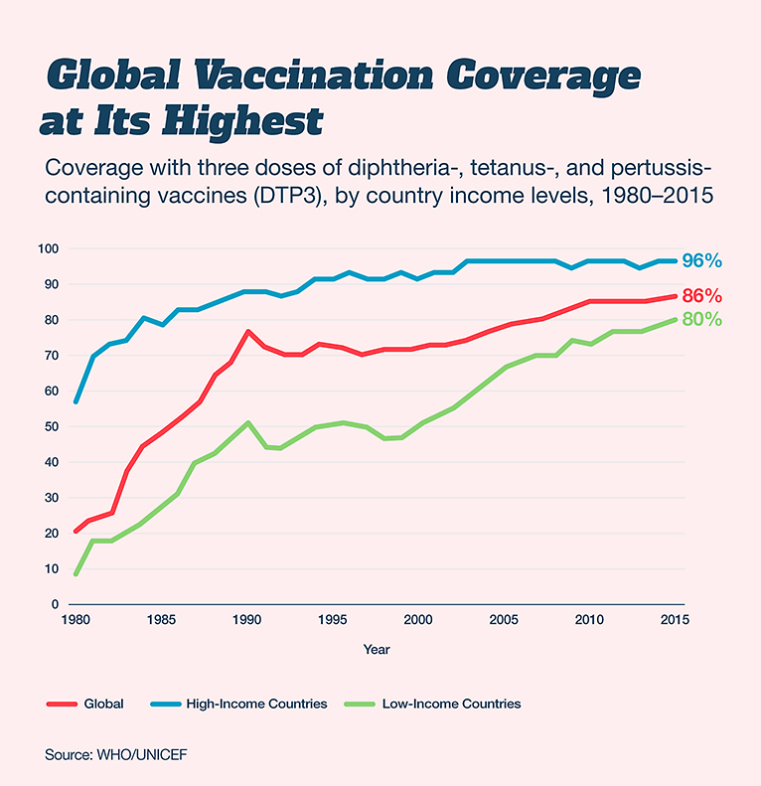
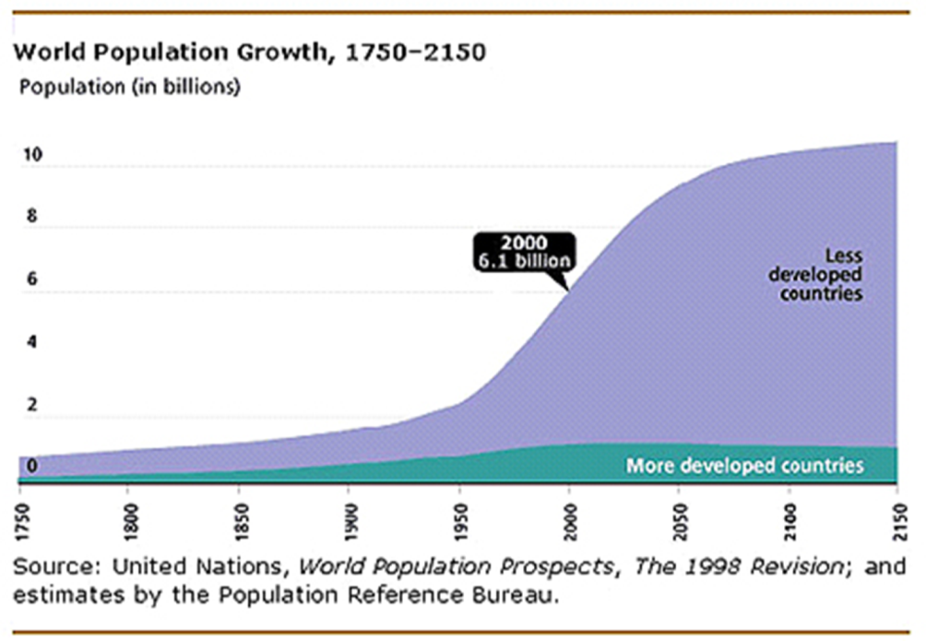
Our Challenge : Vaccination for all people Our Chance: Global Partnerships
The developing world needs more vaccines
1980 Smallpox Eradication
4 billion
Penicillin in 1928
2 billion
Gavi, GF EVI, IVI, IVR, MMV, UNAIDS, STOP TB… DCVMN,
1988: Polio Eradication
https://www.gatesnotes.com/2017-Annual-Letter

Slide 5
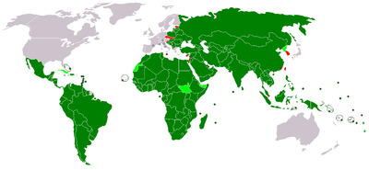
Developing Countries Economies
developing economies according to the UN & IMF
transitioning to developed economy
https://www.un.org/development/desa/dpad/wp-content/uploads/sites/45/WESP2019_BOOK-web.pdf

Slide 6
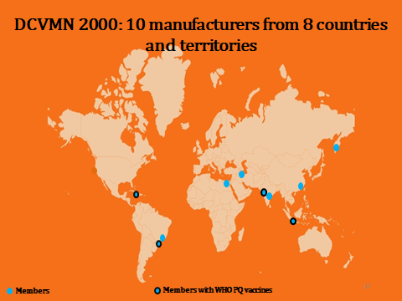

Slide 7
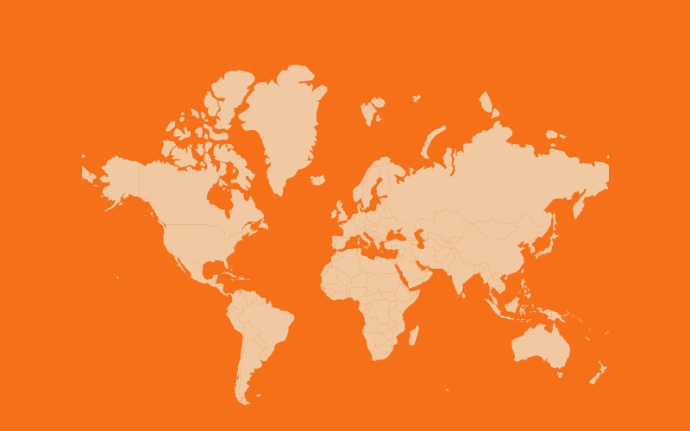
DCVMN 2011: 25 manufacturers from 13 countries and territories
Members as of Jan 2012
Members with WHO PQ vaccines

Slide 8
DCVMN 2014: 41 manufacturers from 16 countries and territories
Members as of Jan 2015
Members with WHO PQ vaccines

Slide 9
DCVMN 2016: 50 manufacturers from 17 countries and territories
Members as of Jan 2016
Members with WHO PQ vaccines

Slide 10
DCVMN 2019: 43 manufacturers from 14 countries and territories
A global network of 43 manufacturers producing vaccines for over 170 countries.
The largest alliance of vaccine manufacturers worldwide.
Network supplied 1.3 billion vaccine doses to UNICEF in 2017.
35% of manufacturers are state-owned institutions
Members as of Sep 2019
Members with WHO PQ vaccines
Notes:
From 2011 to 2019 we DCVMN network grew 5 fold. Throughout the history of the Network the majority of the manufacturers have been based in the Asia-Pacific region.
However, in 2017 almost 30% of members came from other regions, notably from Latin America or the Middle-East. Fast-forward to now and the number of members from Latin America and the Middle-East has decreased to 4 members. The concentration of members in Asia is not a problem but an international alliance should have strong representation from all areas of developing countries.

Slide 11
DCVMN Contributions to the Global Vaccination Landscape
Tetanus elimination

Slide 12
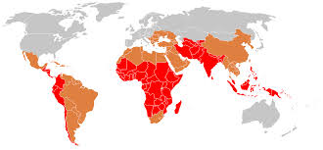
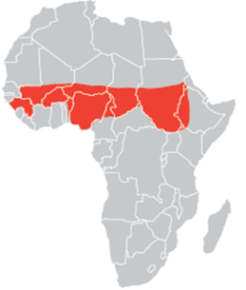
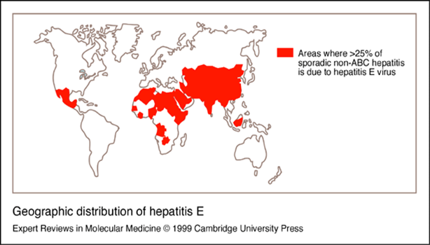
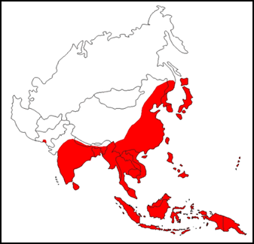
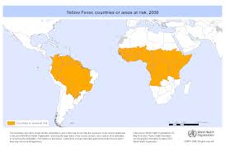
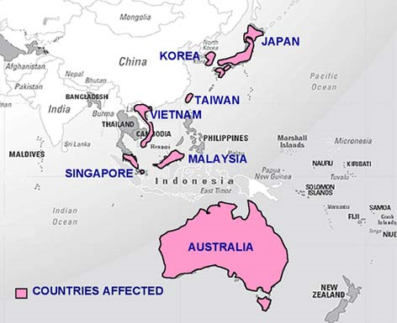
DCVMs preventing regional infectious diseases
New conjugated
Typhoid Fever vaccines
Hepatitis E vaccine
MenAfriVacTM
Japanese
encephalitis
EV-71 Enterovirus,
HFM
Yellow Fever Vaccines

Slide 13
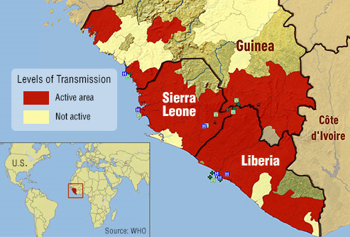
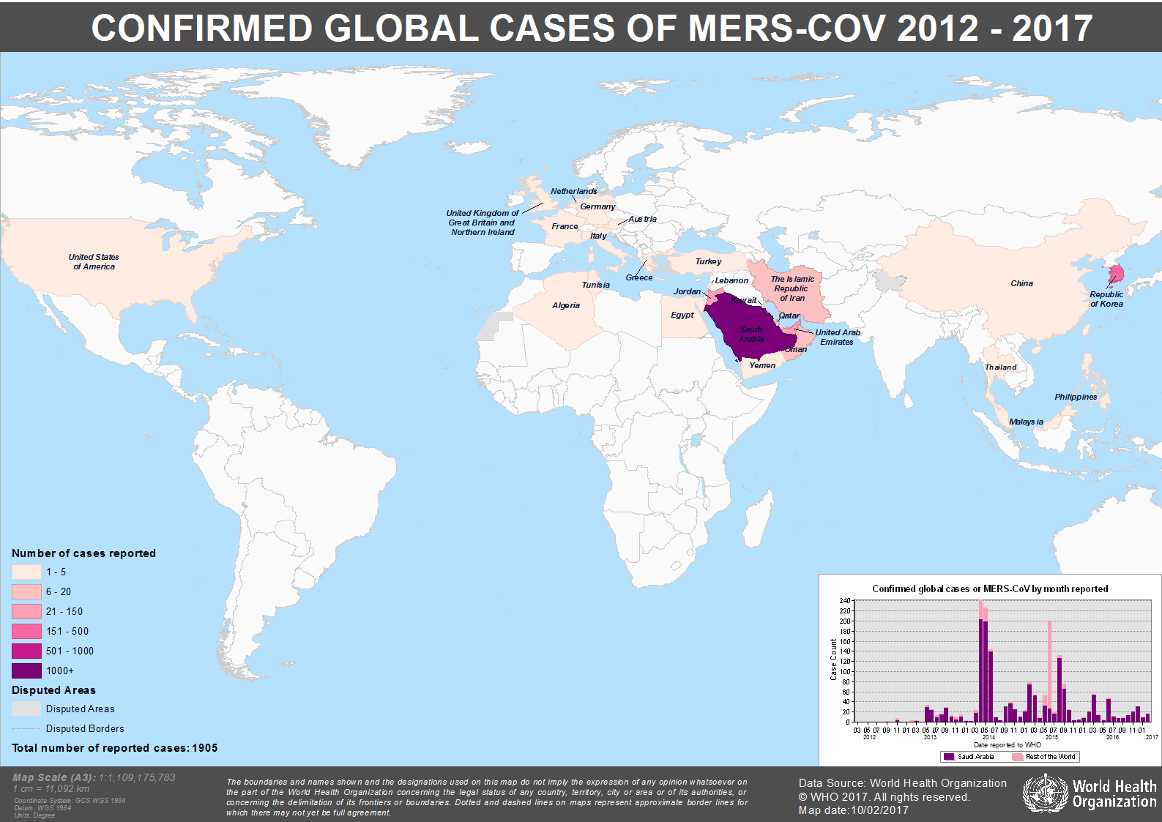
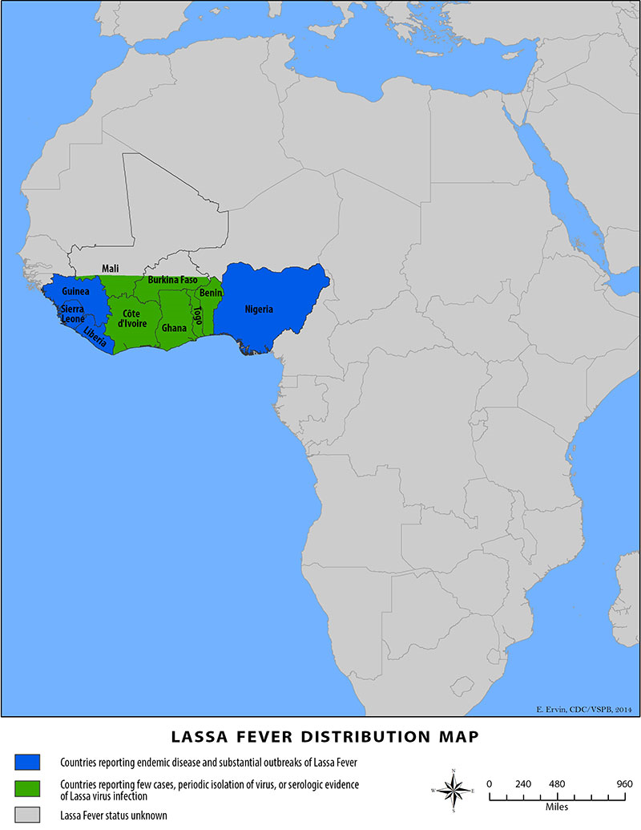
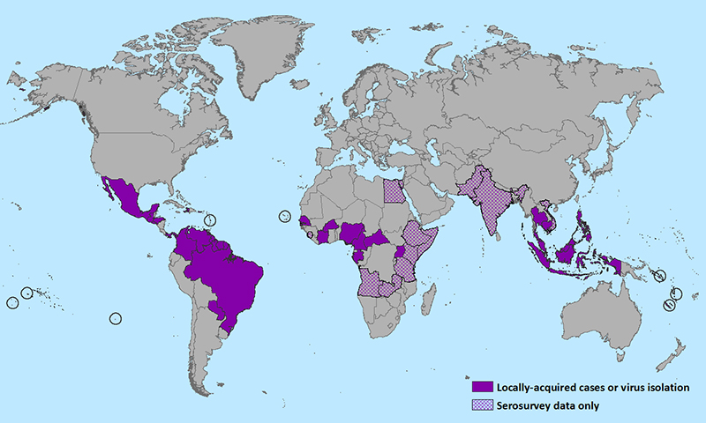
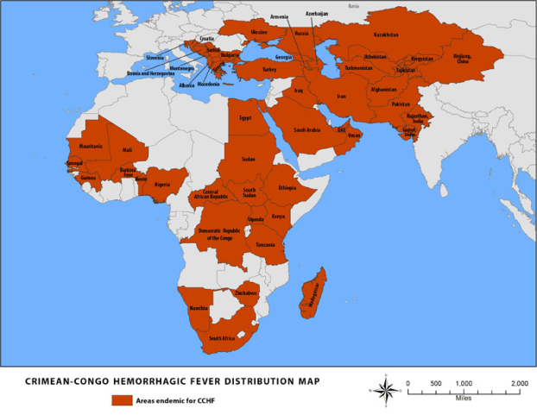
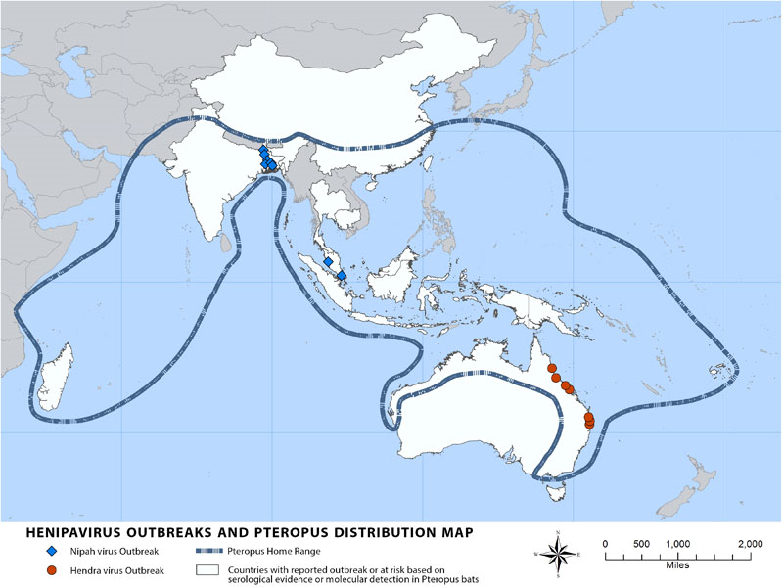
Outbreaks with epidemic potential
Ebola
MERS
LASSA
ZIKA
CCHF
NIPAH

Slide 14
Three main common goals 2019-21:
01
02
03
Build capability, delivery
Engage with members
Engage with international bodies
Through 6 initiatives:
1. Expand training program
GDP, GCP, GLP, GPVP
2. Sharing best practices
Expert working groups
3. Regulatory convergence
Test methods, submissions
4. Access to expertise
Databases, webinars
5. Technology adoption
through AGM engagement
6. Pharmacovigilance
System strengthening
14

Slide 15
A history of DCVMN impact on vaccine innovations
1997: First bivalent oral cholera vaccine by Vabiotech
2008: First fully-liquid Pentavalent (DTwPHepBHib) by Panacea
2010: First meningitis A vaccine specially made for Africa by Serum Institute
2012: First Hepatitis E vaccine by Innovax
2013: First conjugated typhoid vaccine by Bharat Biotech
2015: First Sabin-based IPV vaccine by IMBCAMS
2015-16: First & second EV-71 (HFMD) vaccines by IMBCAMS & Sinovac
2015: First cell-based influenza vaccine by SK biologicals
2017: First oral cholera vaccine available in plastic vials, by Eubiologics
2017: First thermostable rotavirus vaccine by Serum Institute
2017: First fully-liquid Hexavalent vaccine based on whole-cell pertussis by
Panacea (DTwPHepBHib-IPV)

Slide 16
ZIKA
Although symptoms of Zika virus infection are typically mild, infection during pregnancy is now associated with microcephaly in newborn.

Slide 17
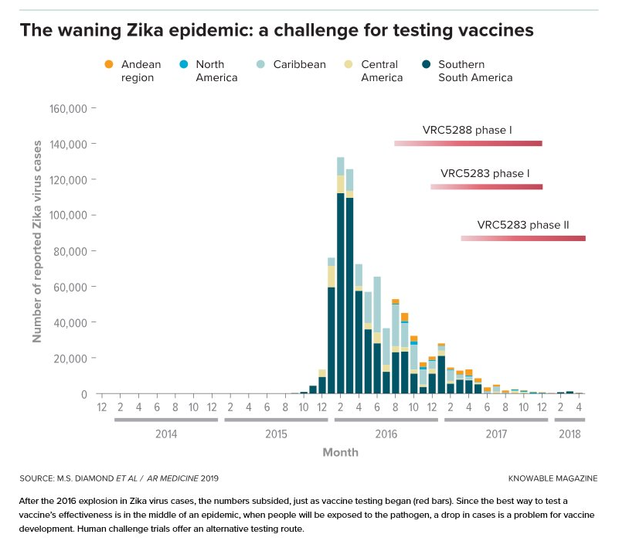

Slide 18
Concluding remarks on HIC
Equal access to scientific information and R&D opportunities
May reduce the length of time needed to conduct clinical trials to months
Help de-select non-efficacious vaccine candidates
Serve understanding the innate immune responses to pathogens
To date, most human challenge studies have been conducted in high income countries
India is working on a framework that will allow scientists and clinicians to observe the progress of infection in healthy volunteers and the efficacy of a vaccine-induced immune response
Manufacturers are encouraged to meet with regulators as early as possible to discuss options for registration pathways and/or post-licensure studies and HIC
https://www.sciencedirect.com/science/article/pii/S0264410X18317134

Slide 19
Individually we are one drop, together we are an ocean
Ryunosuke Satoro
DCVMN International
www.dcvmn.org

Slide 20
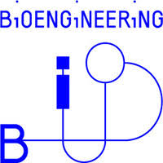
DCVMN Collaborating organizations and Partners

